Slide 1
Open-water Rubbish Collection robot with Automatic sensing (O.R.C.A) – PROJ324
Luke Waller

Slide 2
Initial Project Aims
Create a boat that can float on water
Use a mechanism to scoop/collect the litter
Create a control system for the craft that will allow it to be remotely operated

Slide 3
Inspiration for the project
Harbours and standing bodies of water are continually getting more polluted and this is all ending up in the ocean.
Pollution in the sea is increasing at a rate of 8.3 million tonnes each year.
It is estimated by 2050 the amount plastic in the sea will outnumber by the number of fish.
There are now over 500 dead zones where marine life cannot live.
This is a worsening problem that needs to be fixed otherwise the damage will be catastrophic. (https://www.condorferries.co.uk/marine-ocean-pollution-statistics-facts)

Slide 4
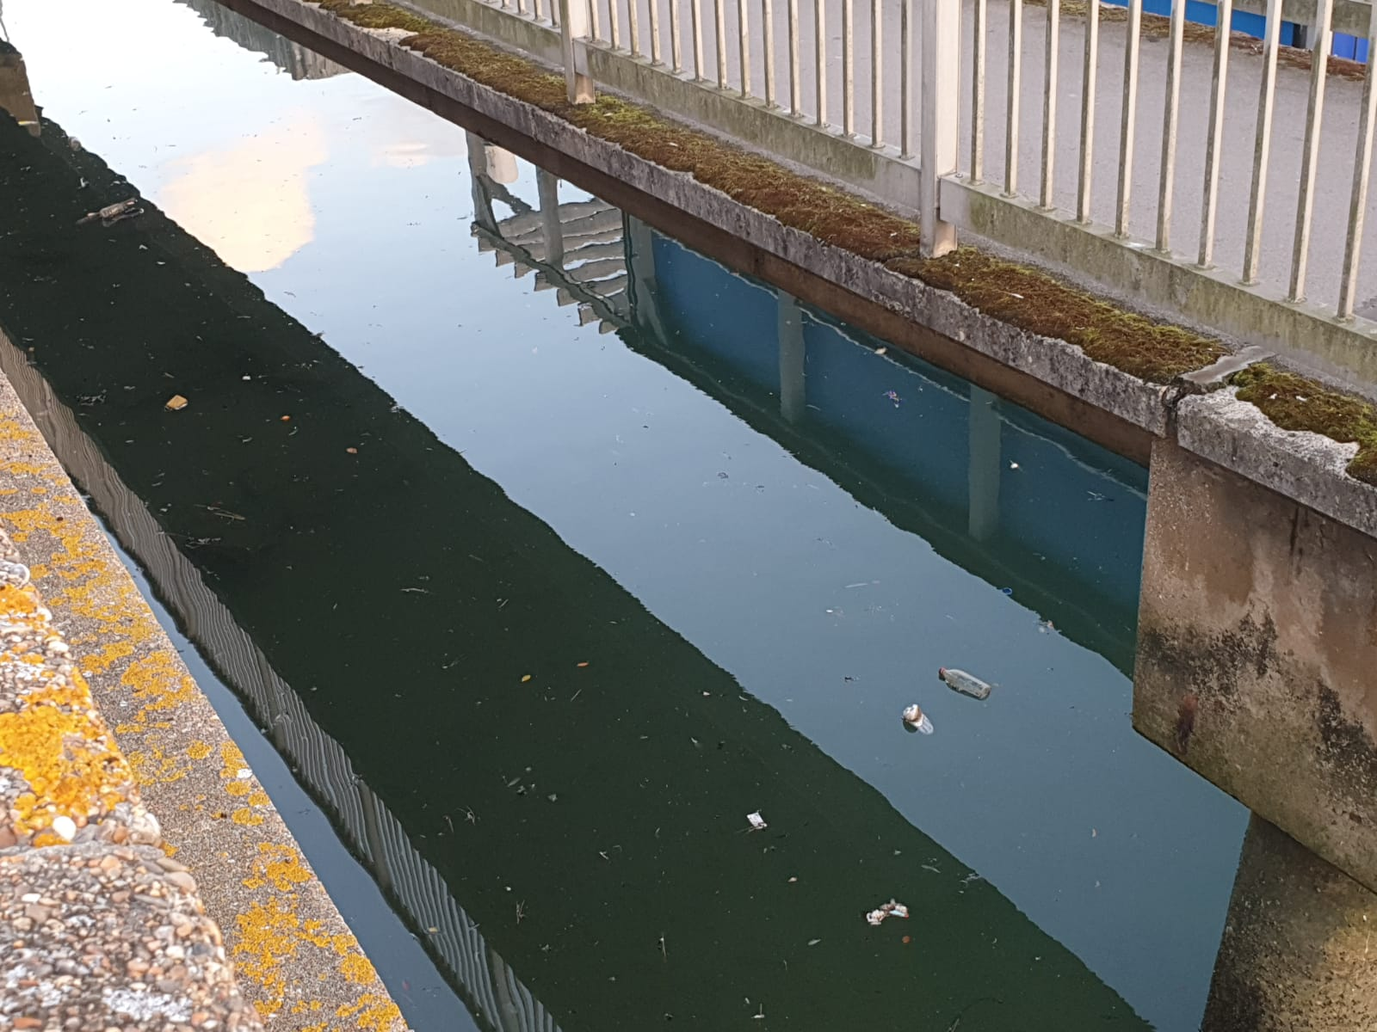
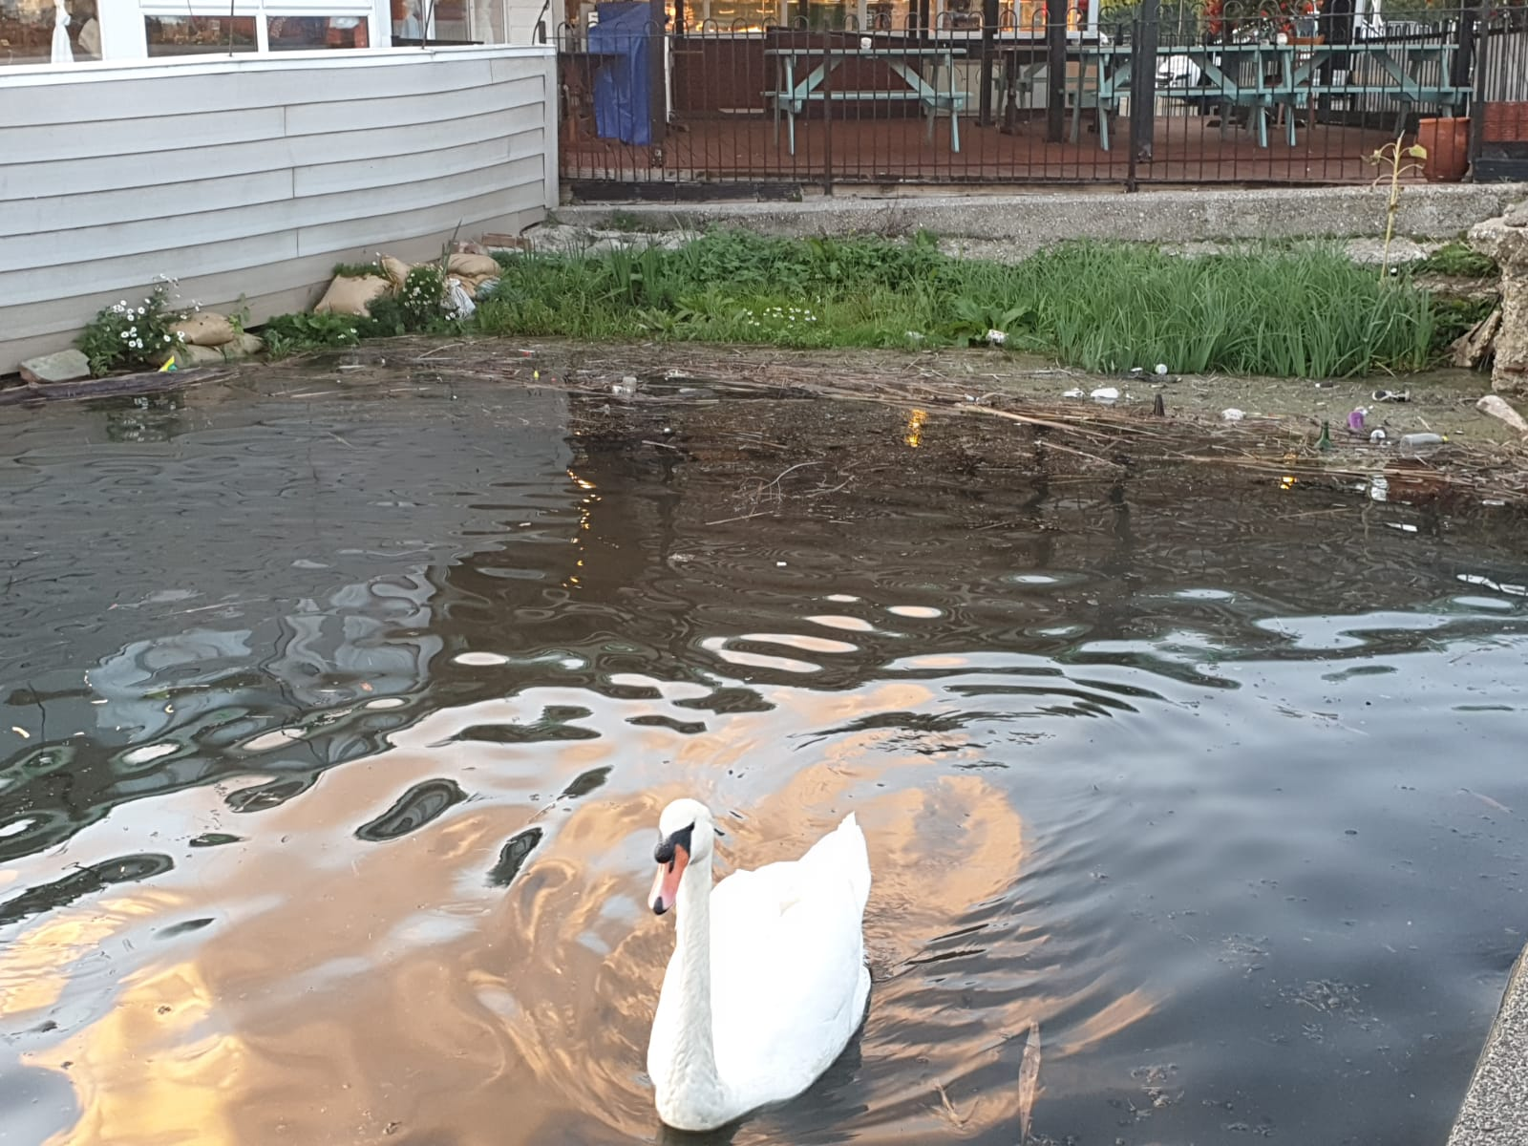
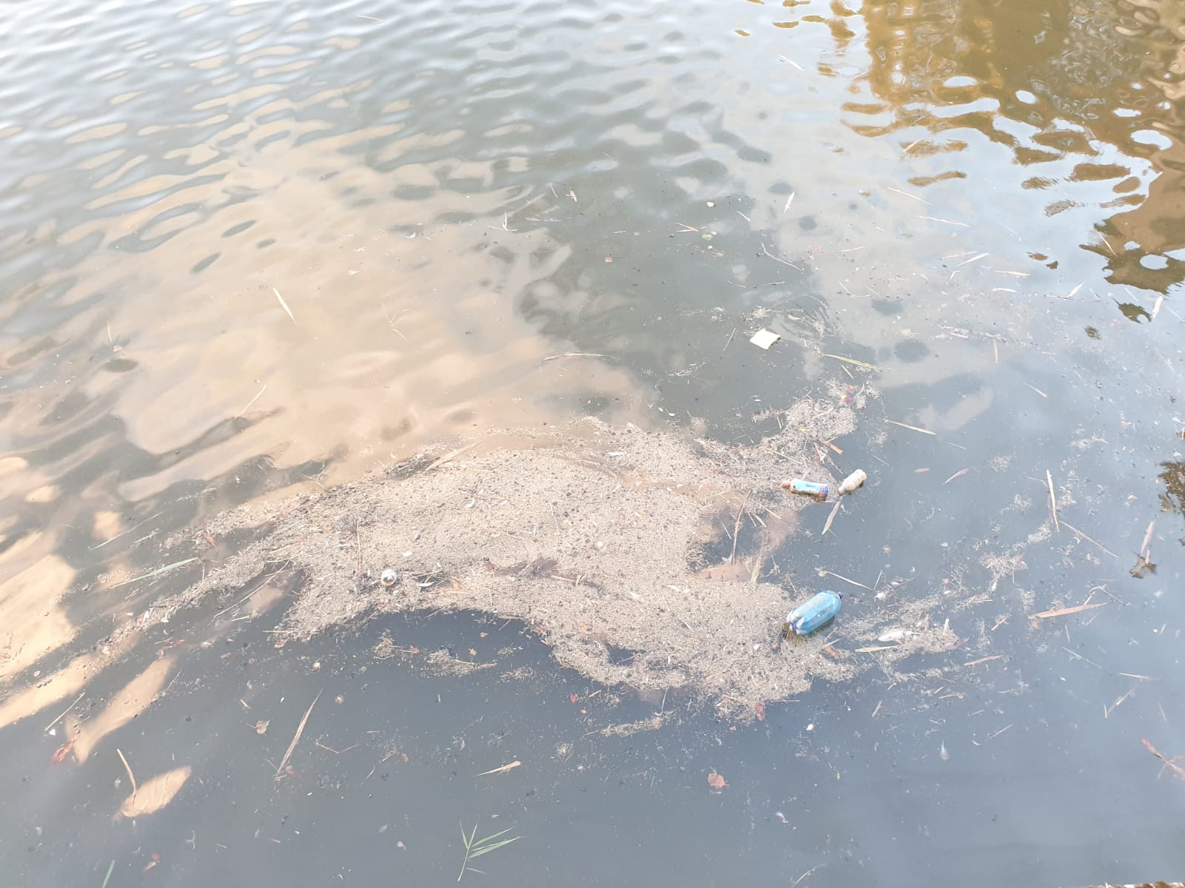
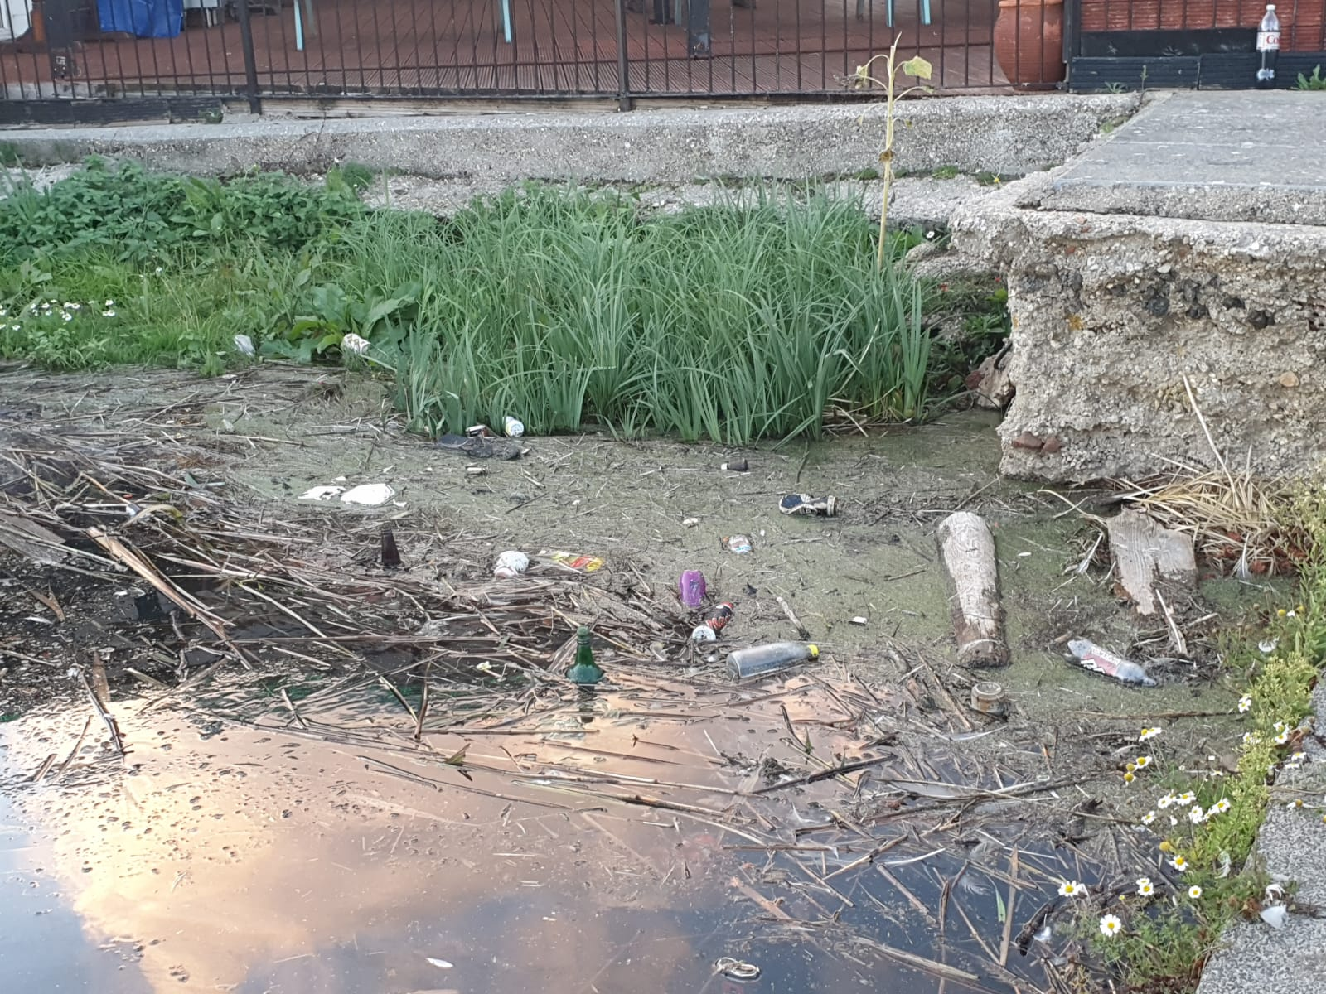
Local images of reservoir in Weymouth
This was one of the biggest inspirations for the project
Lived near this reservoir for over 20 years
Local wildlife must live among it

Slide 5
Current Progress
Mocked up a floating prototype and evaluated its estimated load capacity.
Research into buoyancy and the effects of saltwater vs fresh water
Begun investigation into potentially viable propulsion mechanisms

Slide 6
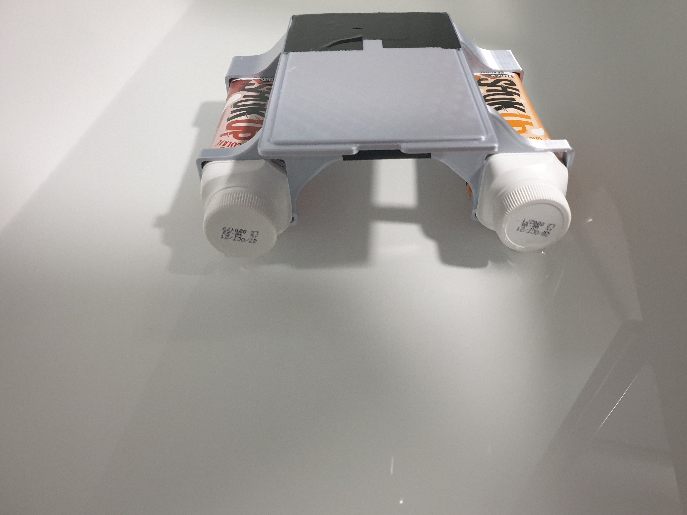
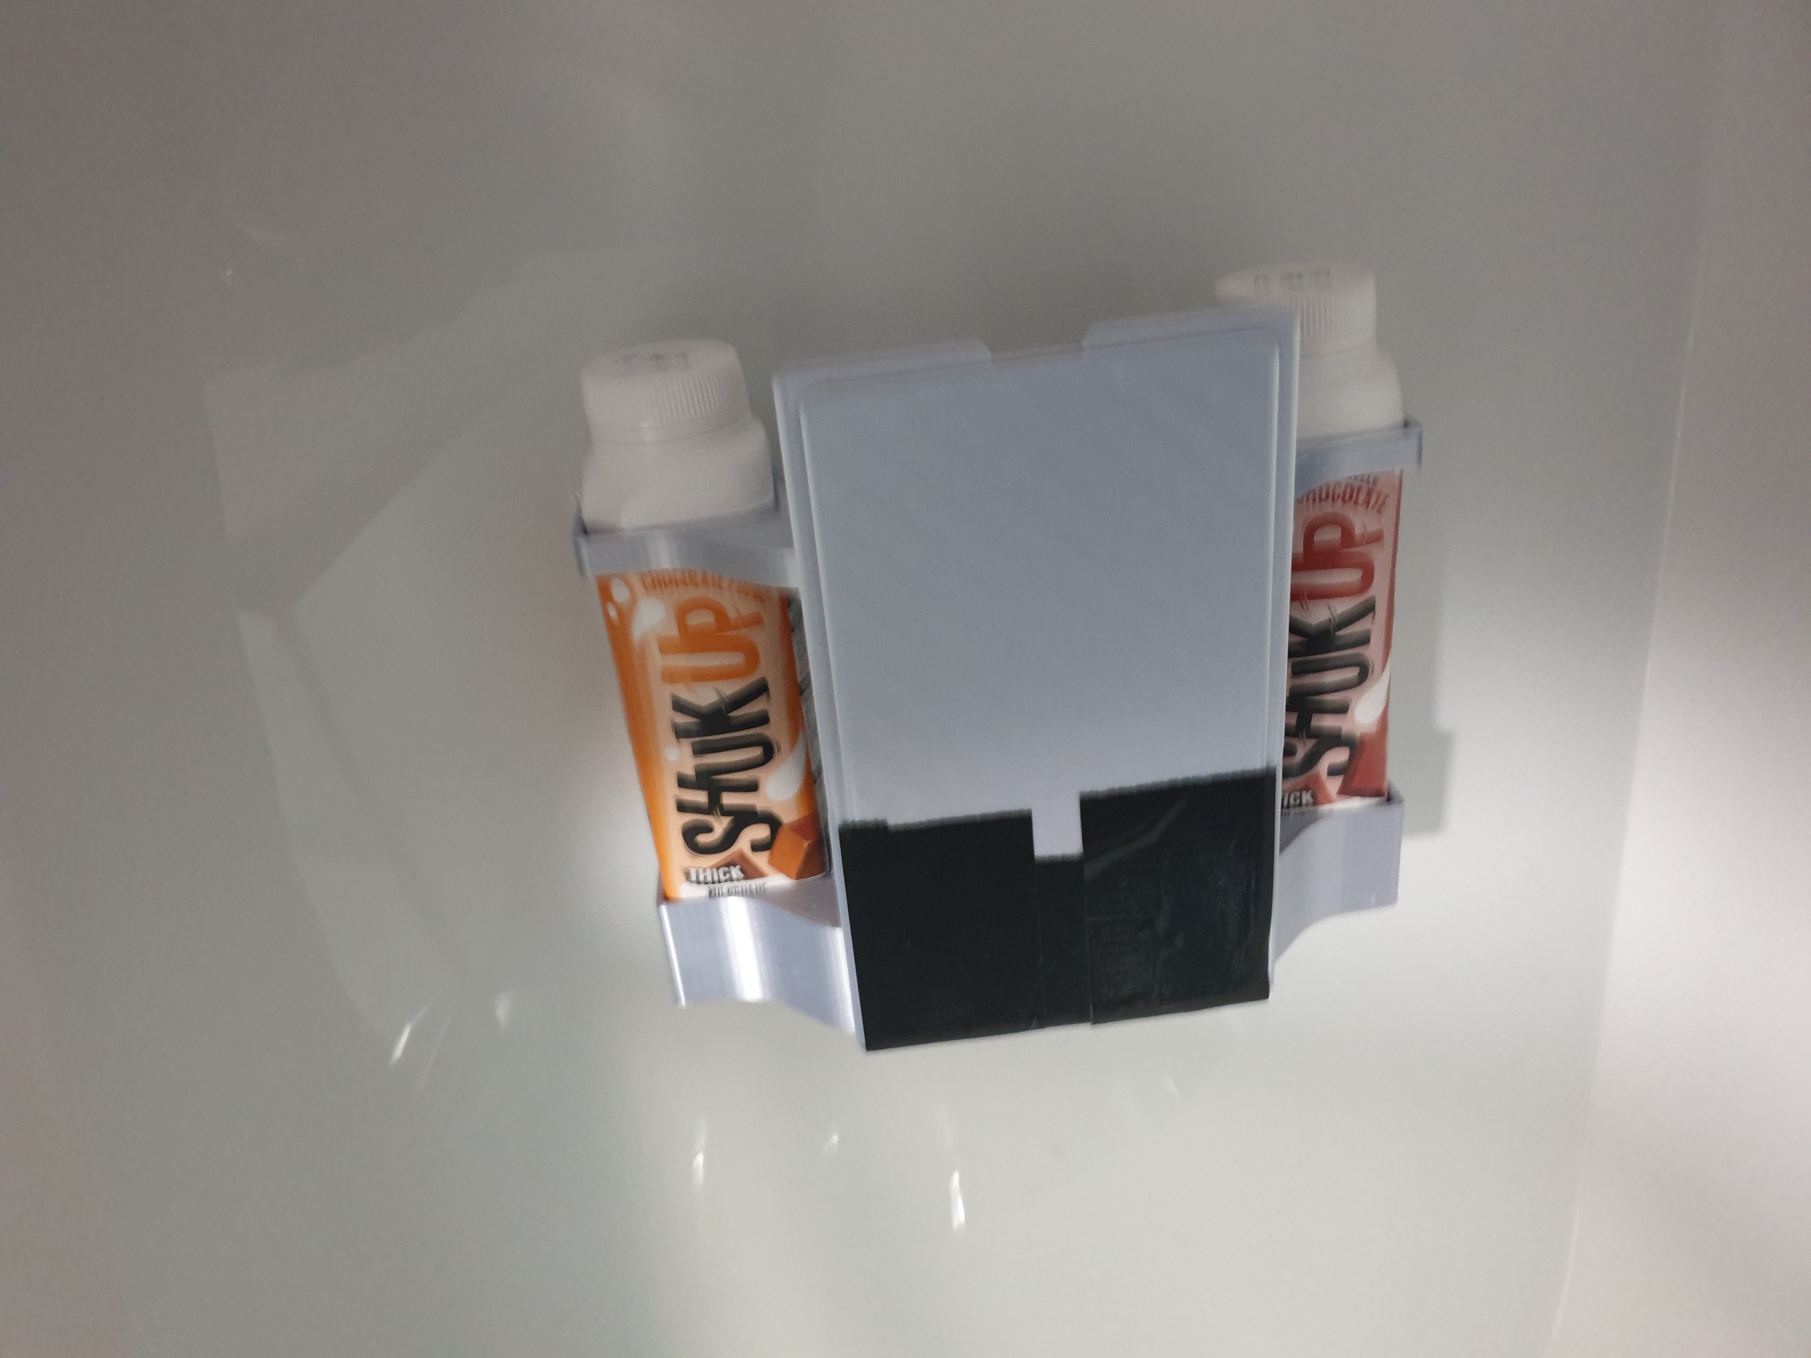
Floating prototype
This protype was quickly made to estimate approximate carrying capacity for small craft.
This was put in the bath and can be seen to be floating on the surface.

Slide 7
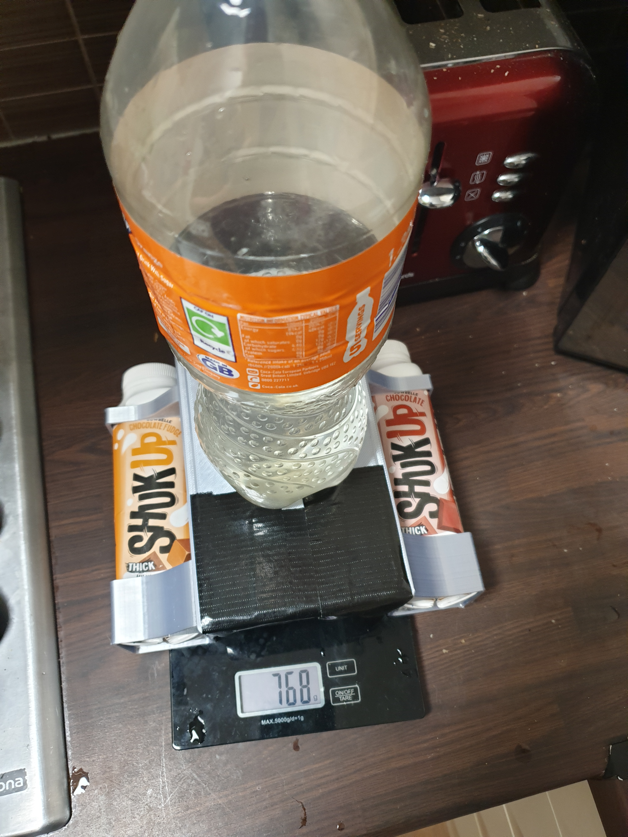
Prototype at maximum capacity
The soft drinks bottle was filled up with water until the craft only just managed to float on the surface.
This was deemed to be the crafts maximum load and was measure to be at 768g.

Slide 8
Buoyancy Research
The buoyancy of fresh water and saltwater differ.
The density of fresh water is 1000kg/m³ (approx.)
The density of saltwater is 1025kg/m³ (approx.)
Given this, the buoyancy of the prototype would be 1.025 times greater in salt water. Although fairly insignificant at this scale (768g in fresh water, 787g in salt water), it is important to keep in mind as the prototype gets bigger.
Given this, as the corrosive nature of salt water, I have chosen to exclusively test in fresh water.
It would also require a lot of salt to artificially make salt water, 3.5% salt to water by weight. For a typically bath (200L) this would require 7kg of salt.

Slide 9
Propulsion Mechanism(s)
Generally Considered to be 4 types of propulsion:
An Outboard motor – mounted to rear transom (rear wall) of the boat. Engine rotates to control steering.
Inboard Motor – mounted inside the hull in the front or middle of the boat. Engine used to drive a shaft that protrudes out the back of the boat. Shaft does not rotate; the turning is done by a rudder.
Sterndrive – Commonly called inboard/outboard. They drive a shaft like an inboard but are mounted at the back of the boat, like an outboard. The end of the shaft rotates so like the outboard it doesn’t use a rudder.
Jet Drive – Uses a motor and an impeller mounted inside the boat. There is an inlet which sucks up water, speeds it up and blasts it out the back. These type of propulsion is used when high speeds and quick maneuverability are desired.

Slide 10
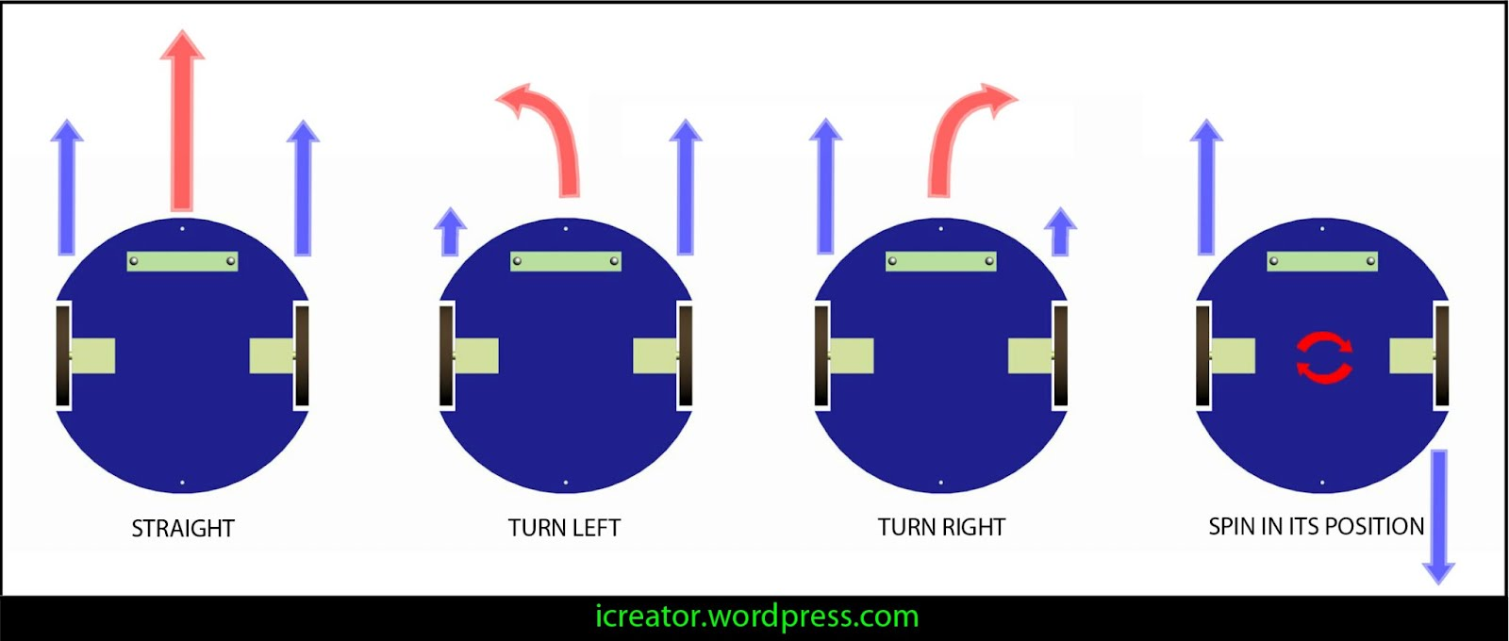
Steering Mechanisms
Looked into using some form of differential technique for steering as shown in the image below.
This would allow the craft to be turned on the spot allowing the craft to more easily navigate tighter spaces that traditional rudder based craft would find potentially difficult to navigate.
A Rudder could be used but that might catch on debris and litter that could cause the loss of control over the craft.
Given the environment that the craft will be operating in, I believe a system with fewer protruding parts would be highly beneficial

Slide 11
Motor Types – Brushless vs Brushed
Brushed
Typically Cheaper than brushless motors
Typically has higher torque at lower speeds
Wear out faster, so need more maintenance
Less options available for hobbies models
Easier to drive that brushless motors, don’t require an ESC
Brushless
More variety of motors available at a hobbyist level
Don’t have brushes so they don’t require as much routine maintenance
Don’t work as well so well at lower speeds, would require a gearbox to reduce the speed and increase the torque of the motor
Requires an ESC to control motor, an additional cost
Typically more expensive than brushed motors
For my preliminary investigations I have decided to use a brushless motor. This isn’t the perfect solution, as it is a quadcopter motor so it only rotates CCW, but it is a motor that I have access to along with its ESC.

Slide 12
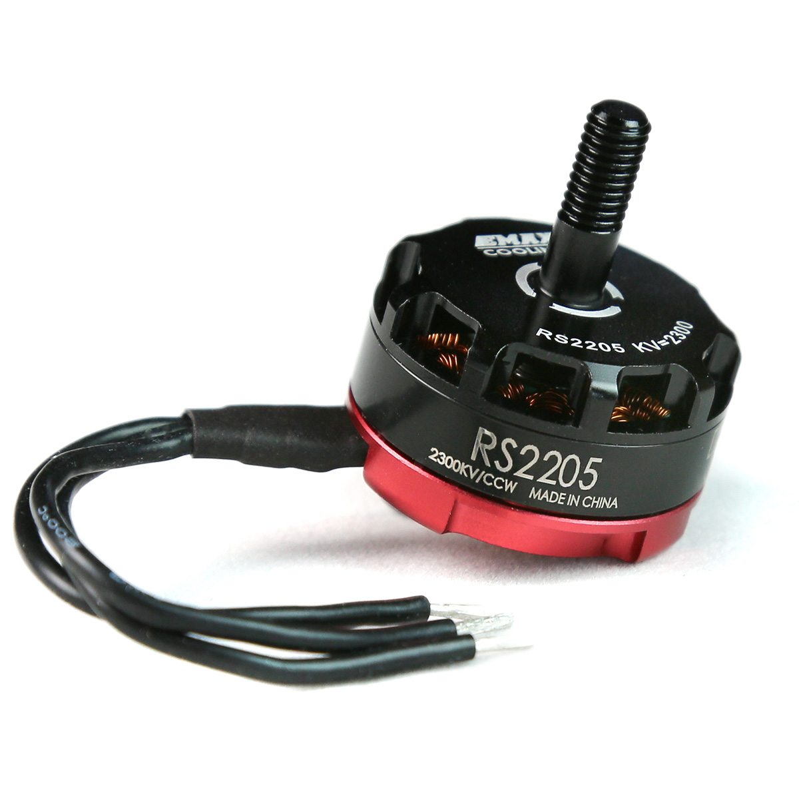
Brushless motor used for Preliminary Research
EMAX RS2205
2600 KV – 2000rpm/V
Drone motor – CCW Rotation
High speed
Fairly Low Torque – especially at low speeds
Cheap
Small
Very commonly used motor in quadcopters

Slide 13
Gearboxes
Use a gearbox to reduce the speed of the motor and increase its torque
On a standard RC controlled boat, the motor doesn’t have a gear box, this makes them extremely fast with rapid acceleration.
For my project I would need to have more granular control on the speed of the craft, for this reason I have decided to incorporate a gear box, this would reduce the top speed, but increase the manoeuvrability
Requirements for the gearbox
Be fully 3D printed (including the gears) – can be done on my mSLA printer
Be watertight – using a rotary shaft oil seal – keep the grease in and keep the water out
Be lubricated using vegetable oil – this is easily obtainable and not damaging to the environment (won’t cause an ecological disaster in my bath if the gearbox leaks during testing)
Vegetable oil does oxidise and can get really viscous over time. As it is being used for testing I decided that this would not be a big issue
Only non-3D printed parts – bearings, rotary seal and the motor
Imported the cad models of the bearings, motor, and propellor
All the other parts I designed myself

Slide 14
Gears
Gear reduction of 3:1 used
Gear Parameters: (before scaling)
Hole – 100mm
Pressure Angle – 20deg
Module – 10
Root fillet radius – 1.588mm
Thickness – 100mm
No. of teeth – 25 (on small gear), 75 (on large gear)
Once scaled, the gears need to be placed 25.1mm apart so they mesh correctly
I made the gears then scaled them by 0.05 so they fit the motor I am using, this allowed me to make more precise gears
Initial testing seems to indicate that for short/medium term prototyping, resin 3D printed gears will hold up for testing purposes
Not sure whether 3D printed gears would be a long term viable solution – this would need to be investigated further

Slide 15
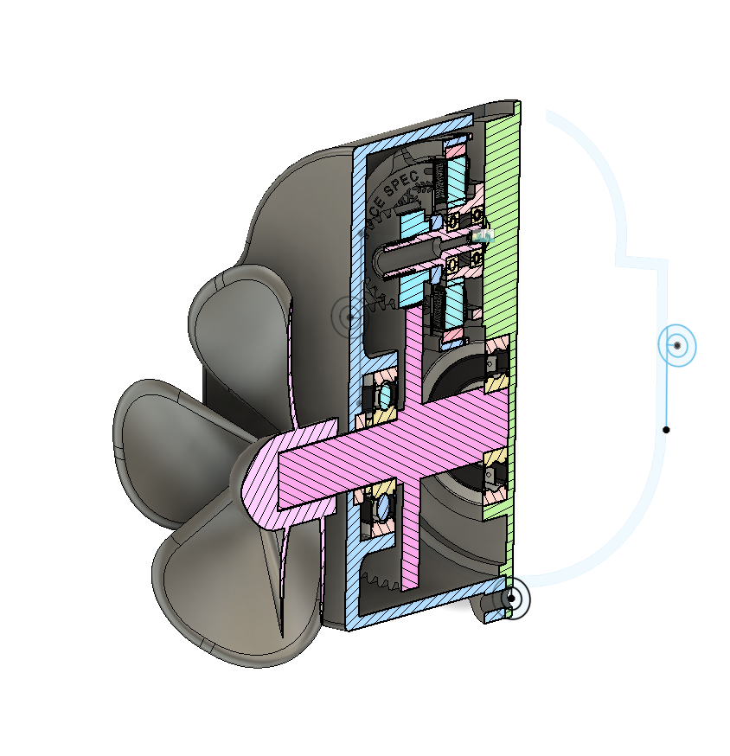
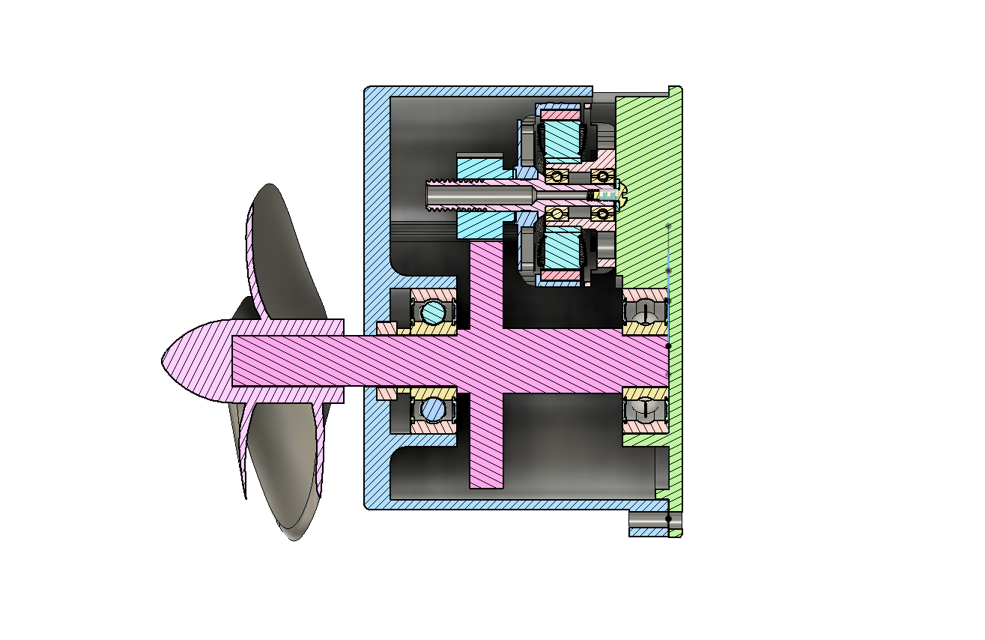
Gearbox (version 1)
Version 1 of the motors had various problems and issues that I was not happy with upon printing.
The tolerance were too tight so none of the bearings or seals fit properly and were causing the shaft to bind up
The main output shaft was too long – this caused it to warp when it was being printed, this caused it to spin off center causing significant wobble in the gearbox
Forgot a cut out behind the motor for the protruding part sticking out the back, this had to be routed out using a rotary tool
Gearbox housing was bulky
Complex part of assembly (the front bearing and rotary seal) was placed at the bottom of the printed part, this made the installation of these parts fiddly and difficult

Slide 16
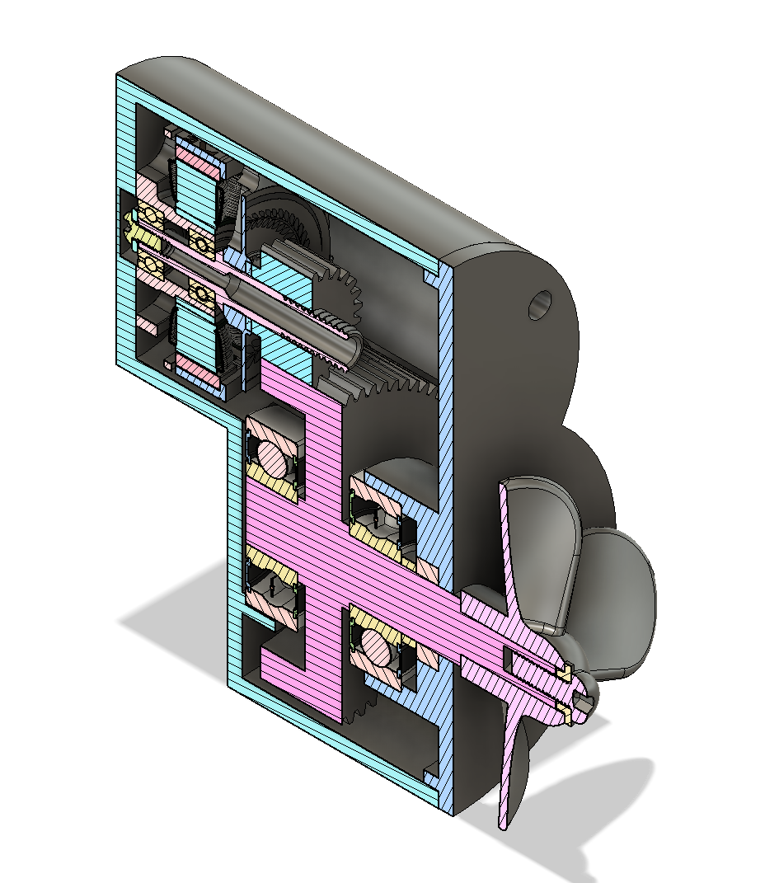
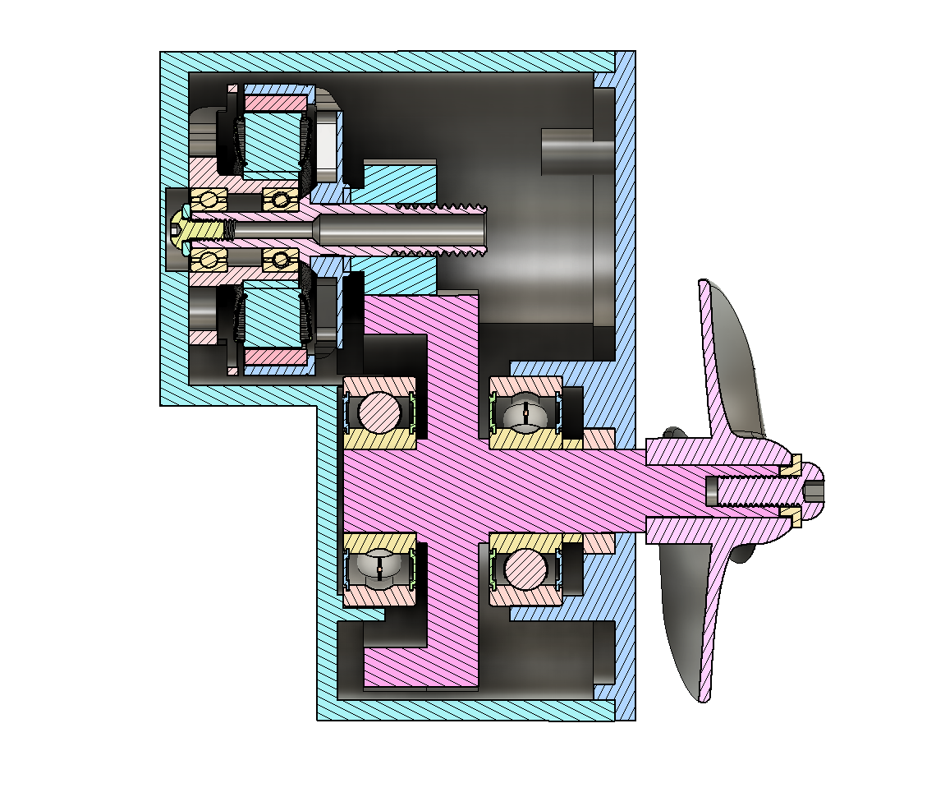
Gearbox (version 2)
Reduced output shaft by 37% - this allowed it to be printed without warping, elevating the warping issue
Placed the bearings for the shaft closer together allowing reducing the size of the gearbox
Increased the tolerance of the parts, reducing the binding issues
Made the front of the gearbox come off, allowing the rotary shaft and bearing to be easily inserted and fitted before installation
Made the hole where the shaft sticks through the gearbox wider as this isn’t the part that creates the waterproof seal
Made cutout in the back to allow protruding part of the motor to rotate freely
Mounting holes to hold the case together were placed in the way so that the motor and output get could not be installed into the gearbox housing

Slide 17
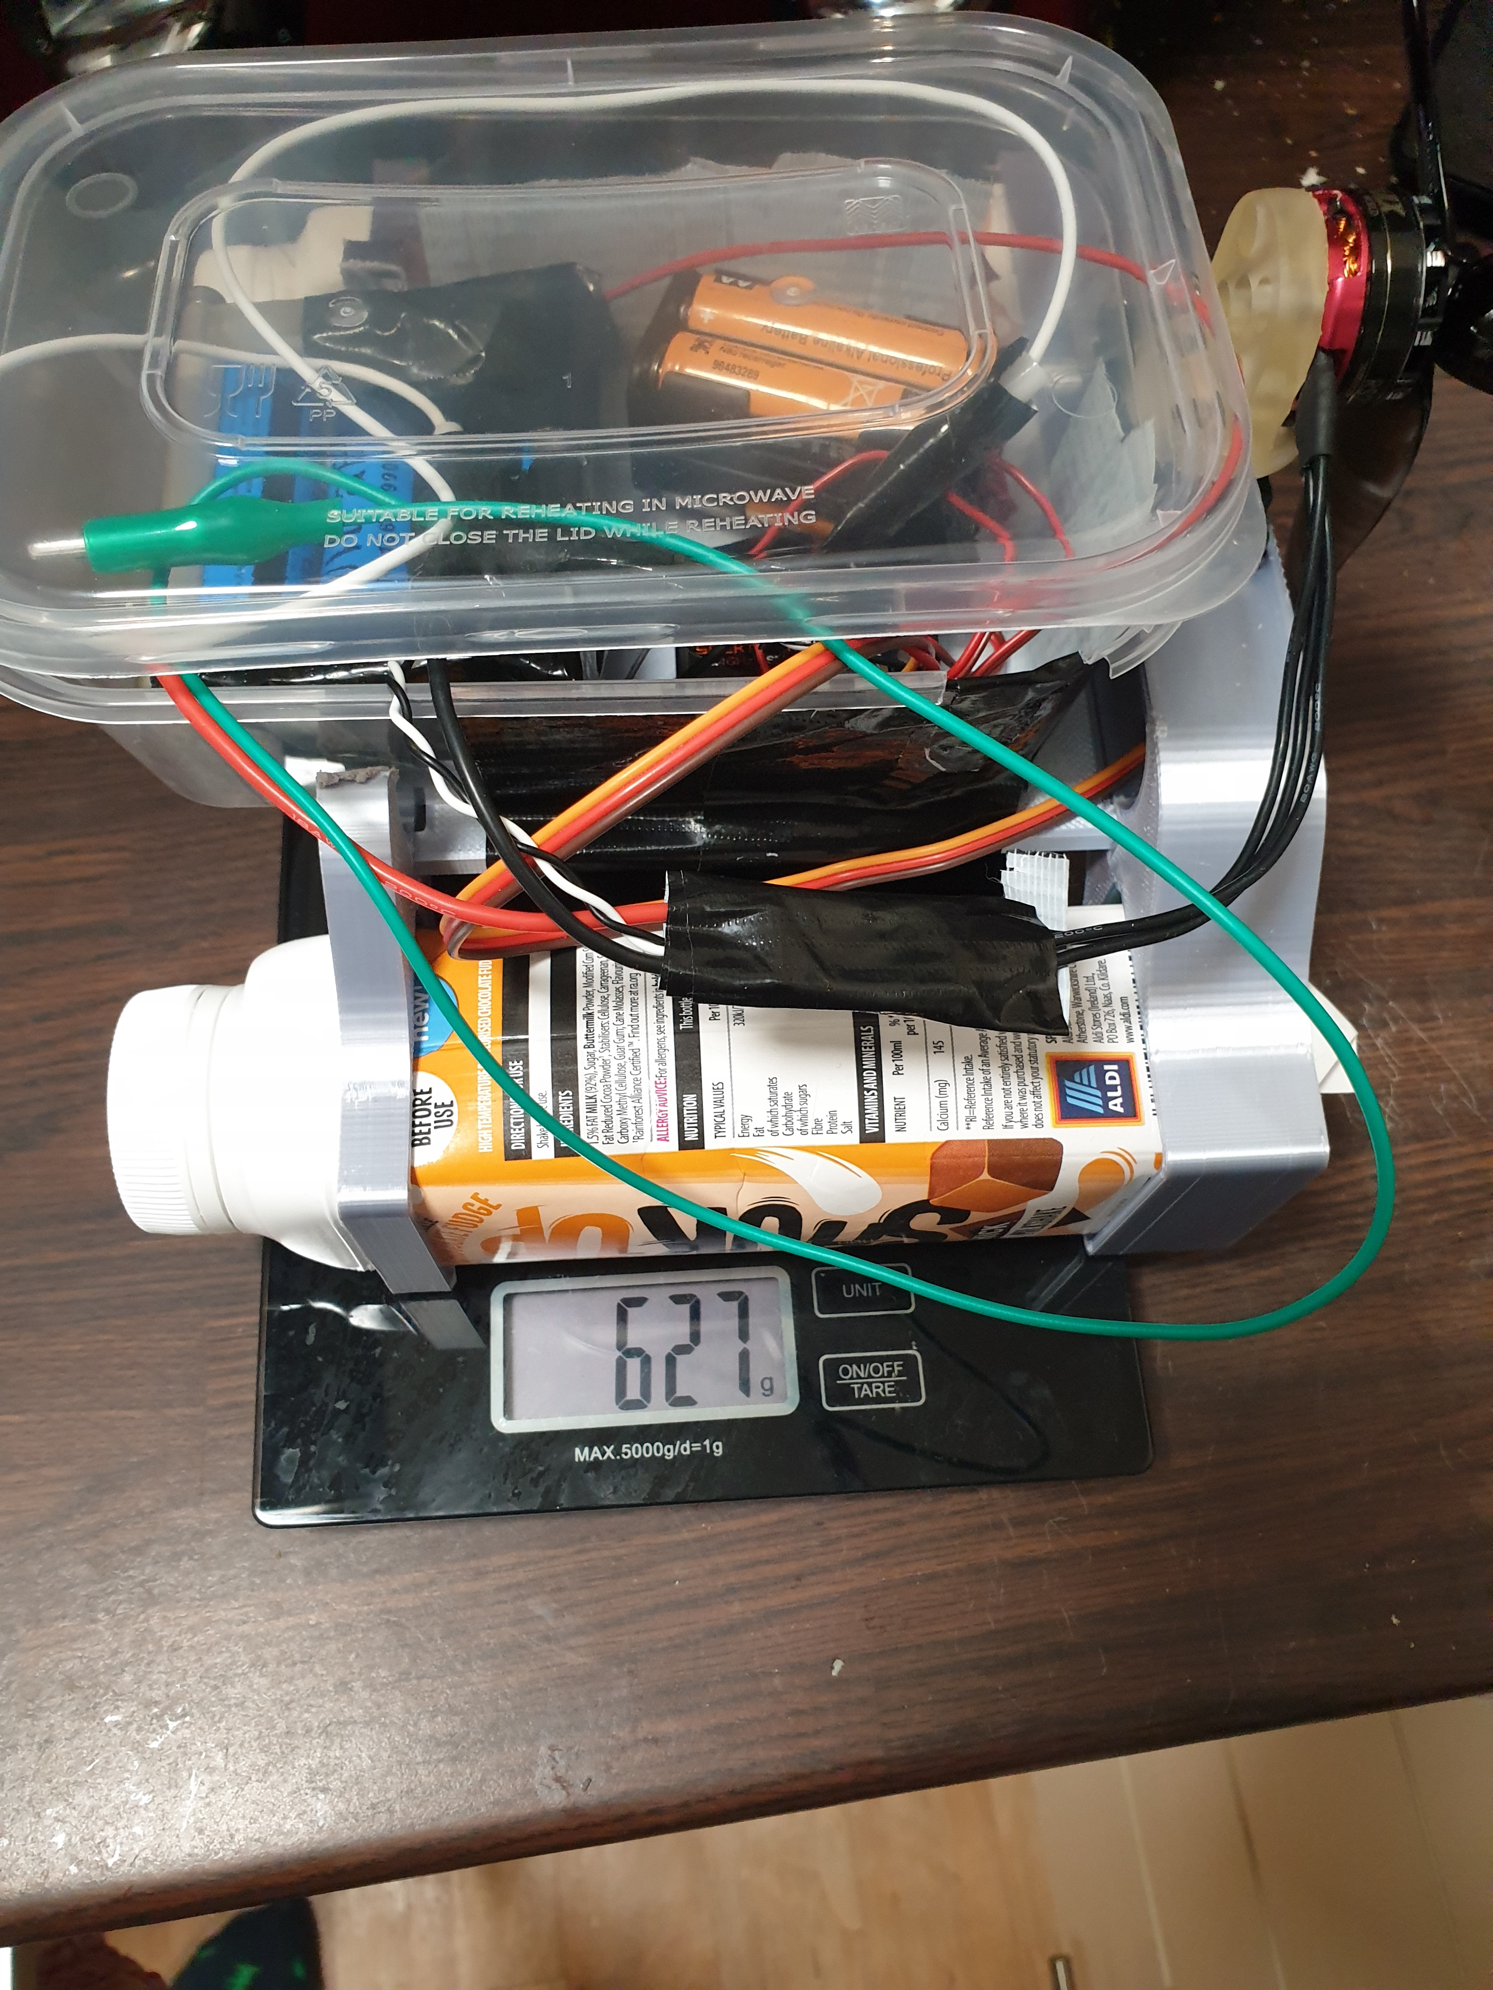
Milkshake Catamaran
Added a quadcopter motor on the back
Included a radio receiver along with batteries to control it
Batteries for the ESC and motor
3D printed mount to hold the fan on the servo motor
Uses commercial propellers from a drone to power the craft
The craft is under capacity but would need larger bottles to allow any additional loads to be carried
Uses three 18650 9900mAh 3.7 cells in series to produce 11.1-12V for powering the motor

Slide 18
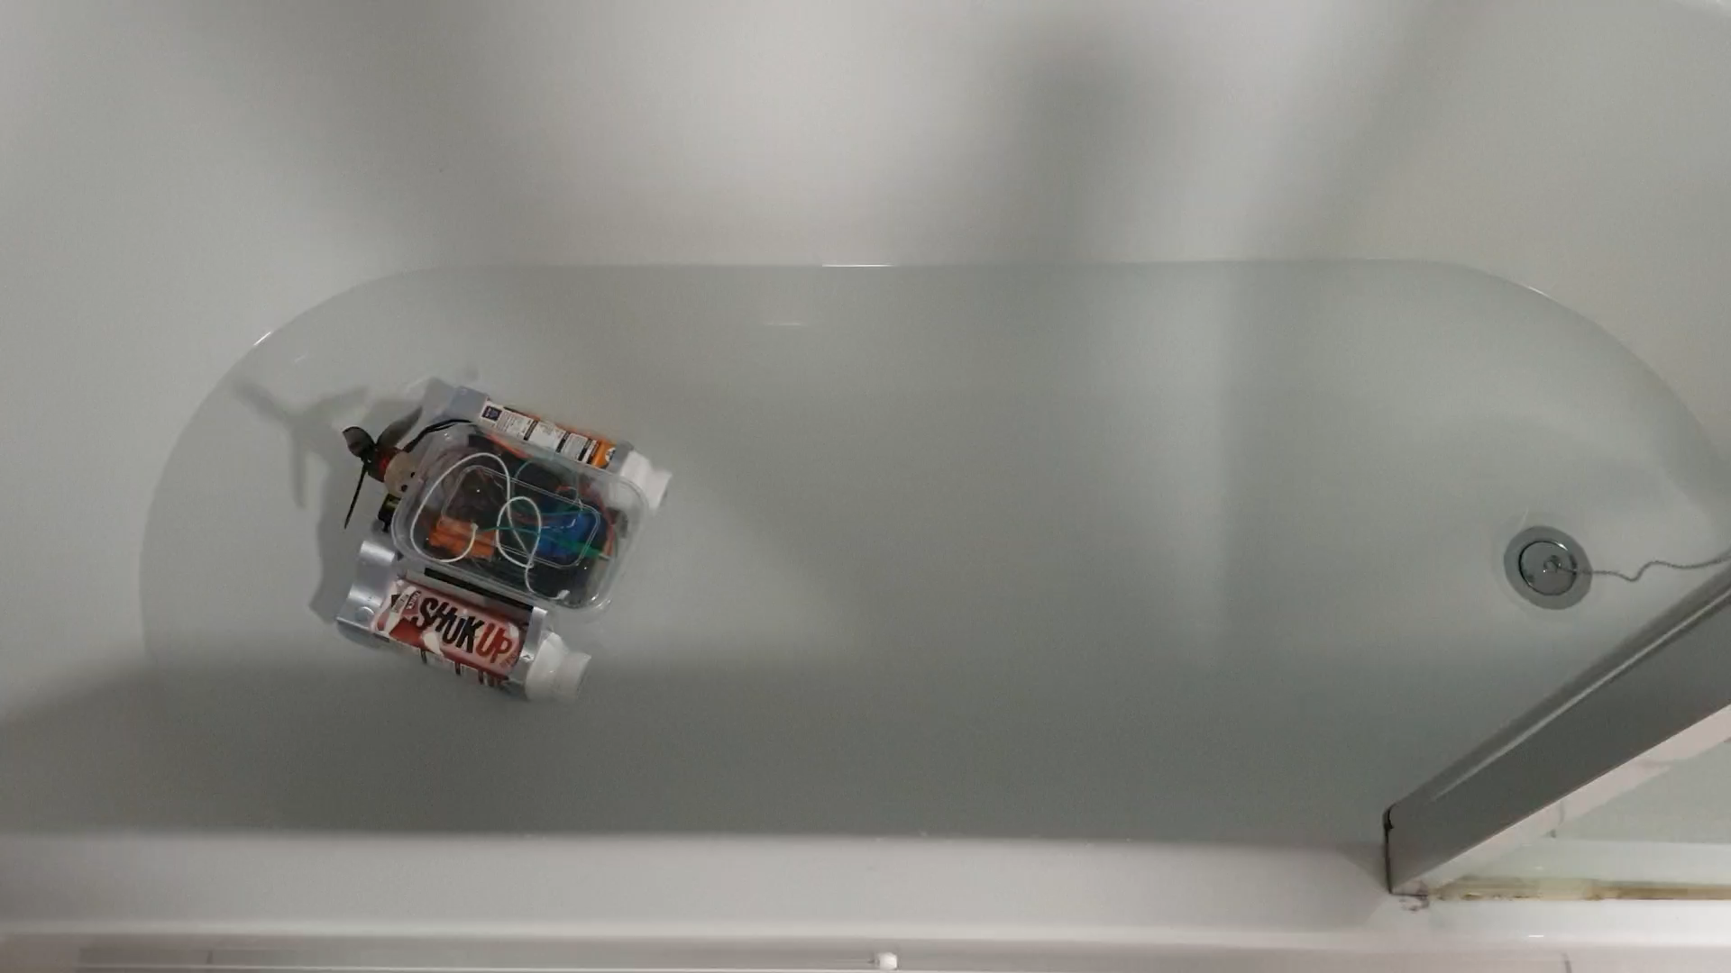
Locomotion tests
Fan is powerful enough to move the craft
Turns sharply to the right, this could be due to the uneven weight distribution in the control box

Slide 19
Problems with V1 Milkshake Catamaran
Only just floats with the current load, this would not be sufficient to add any additional loads to ie. rubbish collection and storage capabilities
The Steering mechanism is overall ineffective, might need to revise this using some form of rudder, either submerged or behind the fan blades
The wiring I was using is not of sufficient thickness, this is fine during testing but could cause issues for sustained use
The craft is very back heavy, causing the rear motors to sit too close to the water
Upon rapid acceleration, this nose pitches downwards and the craft nose dives
The craft is stable in the roll axis but is unstable in the pitch axis

Slide 20
V2 Milkshake Catamaran
Increase buoyancy (by using larger drinks bottles) to allow a greater payload to be carried to allow for rubbish collection and storage
Increase length of the craft to increase pitch stability (to stop the nose diving issues)
Looking into a better method of steering
Adjust the weight distribution to increase stability of the craft
Increase the height of the craft so the electronics don’t sit so close to the water
Better battery storage
Increase waterproofing of the control box
Add switches to the outside of the box to allow craft to be turned on and off without

